Slide 1



Slide 2

SUPERVISOR SELECTION SYSTEM
Supervised by:
Sir Armughan Ali
Group Members:
Sumbal Bano ( SP19-MCS-011 )
Sania Begum ( SP19-MCS-008 )
Presented on
(Cs Department) COMSATS University Islamabad
Attock Campus

Slide 3
Outline
Introduction
Problem statement
Objectives
Existing apps/webs
Methodology
Functional requirements
Tools and technology
Benefits
Diagrams
System screenshots
Conclusion
References

Slide 4
Introduction
Supervisor Selection System is android based mobile application which is beneficial for final year students .
The main aim of our application is to select a supervisor on the basis of their expertise.
This system is to suggest the student best supervisor to select for their FYP.
The application takes the rating from the students and then uses the rating based collaborative filtering to recommend the supervisor to the student.

Slide 5
Problem Statement
Students don’t know which supervisor have expert in which field. Moreover, to find the number of the slots available of every supervisor is also a difficult task.
One of the problem of the manual project work process is that the students must manually filter the documentations of previously done FYPs in the library.
Students can’t discuss every single document with the supervisor. So, there is a need for a discussion board where student can submit their input about a specific report.
There is a manual procedure and takes more effort and time to searching the all information back.
There is no reliable system to collect and store FYP reports and supervisor's information.

Slide 6
Objectives
The main aims and objectives of our system are as under :-
Being the responsive this system will provide proper platform to FYP students.
To provide ease and recommend supervisors to the students for specific fields.
System would rank the list of supervisors recommended on the basis of expertise, past projects, reviews and availbilty of slots .
Usage of this application will help to reduce timing in students and supervisor's difficulties.

Slide 7
Existing apps /web
Features | Supervisor’s Profile with details | Project ideas posted by supervisor | Provide all available supervisor’s list | Vacant- occupied slots of supervisors | Student’s feedback About supervisors
Field-Master Supervisor selection | Yes | No | Yes | No | No
FYP Evaluation System | Yes | No | No | No | No
FYP-Management System | Yes | No | Yes | No | No
MMU FYP portal | Yes | No | No | Yes | No
Supervisors Xpress | Yes | No | Yes | No | No
Schoolgirl supervisor Extended | Yes | No | Yes | No | Yes
UTAR FYP portal | Yes | No | No | No | No
Supervisor Selection System (Own App) | Yes | Yes | Yes | Yes | Yes

Slide 8
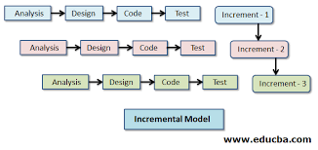
Methodology
We are using incremental model for the development of our project application. The incremental model can divide the whole system into smaller parts called increments and each increment has its own feature or functionalities.
It allows changes if needs be or it our evaluators or supervisor propose any changes we can easily make it.

Slide 9
Functional requirements
Students
Signup
Login
Profile
Faculty List
Inbox
Current Supervisor
Repository
Supervisor Feedback
Logout

Slide 10
Functional requirements
Supervisor
Signup
Login
Profile
Add idea
Inbox
Students Requests
My fyp students
Marks criteria
Repository
Logout

Slide 11
Functional requirements
Admin
Login
Add User
Disable User
Disable batch
Add Batch
Change Supervisor
Repository
Logout

Slide 12
Tools and Technologies
Tools & Technologies | Rationale
Python | Programming language
MS word | Documentation work
MS PowerPoint | Presentation work
Star UML | Diagram work
Android Studio | Programing tool
Firebase Real Time Database | Backend work

Slide 13
Benefits
Reducing time of searching related supervisors as before in manual system.
Ensuring that by using this system students can get best supervision .
Provide platform to students in the selection of supervisors of all area of interest on experty basis .
Supervisor upload own ideas of related field.
The system will provide better communication system between the student and the supervisor.

Slide 14
Diagrams
Use Case Diagrams
Student Use Case Diagram
Supervisors Use Case Diagram
Supervisor selection System Use Case Diagram
Activity Diagrams
Students Activity Diagram
Supervisors Activity Diagram
Admin Activity Diagram
Dfd Diagram
Class Diagram

Slide 15
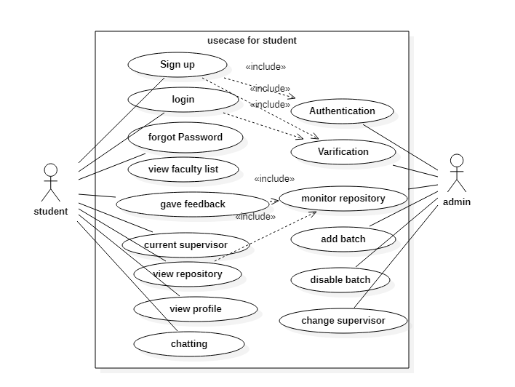
Student Use case Diagram

Slide 16
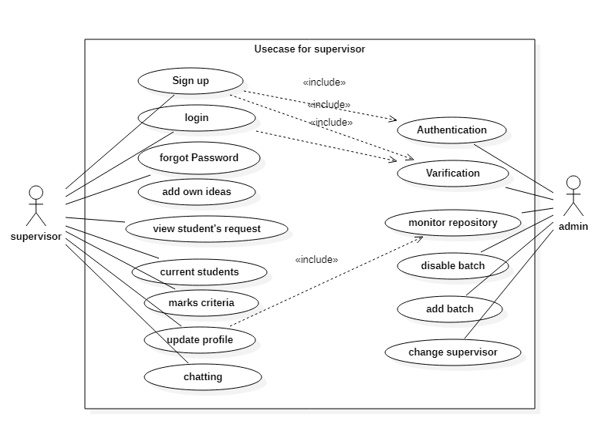
Supervisor Use case Diagram

Slide 17
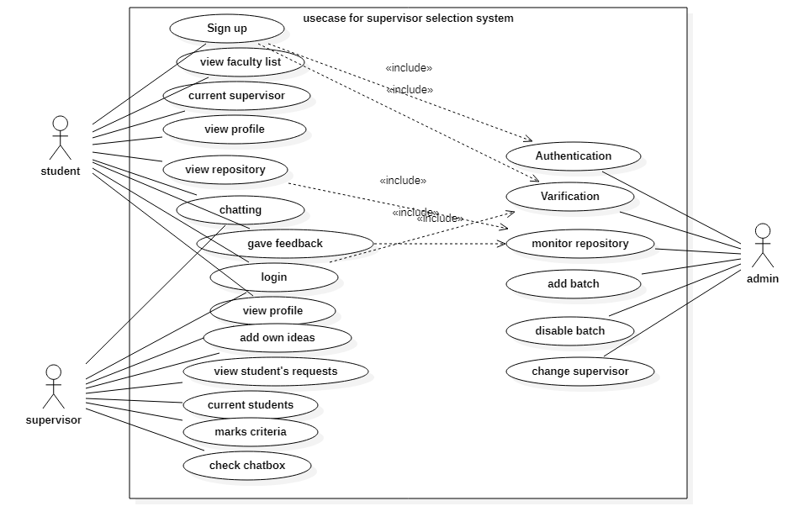
Supervisor Selection System Use case Diagram
17

Slide 18
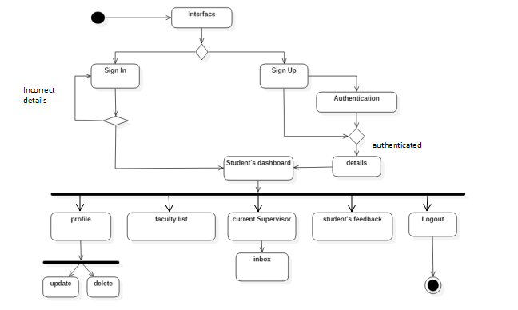
Student Activity Diagram

Slide 19
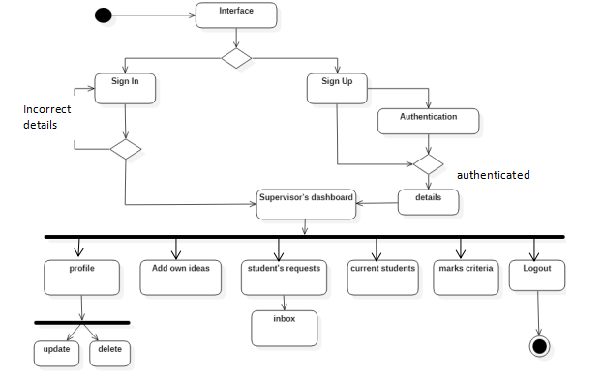
Supervisors Activity Diagram

Slide 20
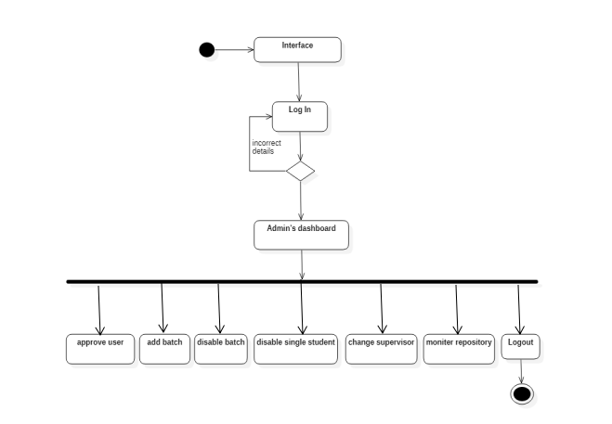
Admin Activity Diagram

Slide 21
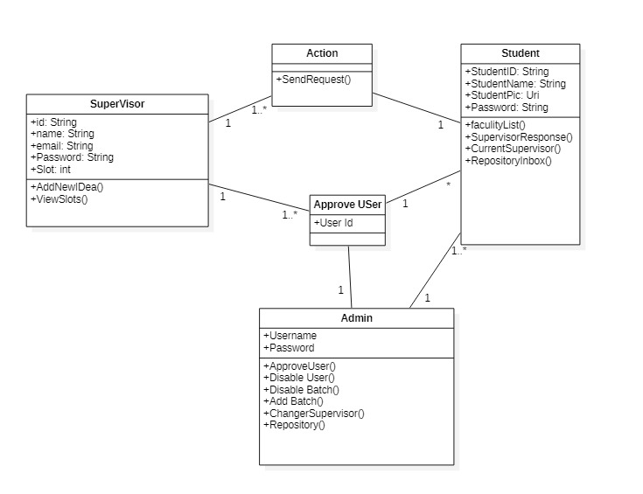
Class Diagram

Slide 22
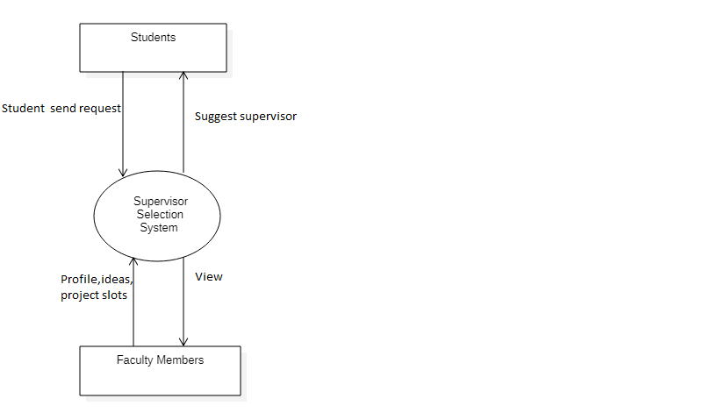
Dfd Diagram(0 Level)

Slide 23

Application Splashscreen

Slide 24
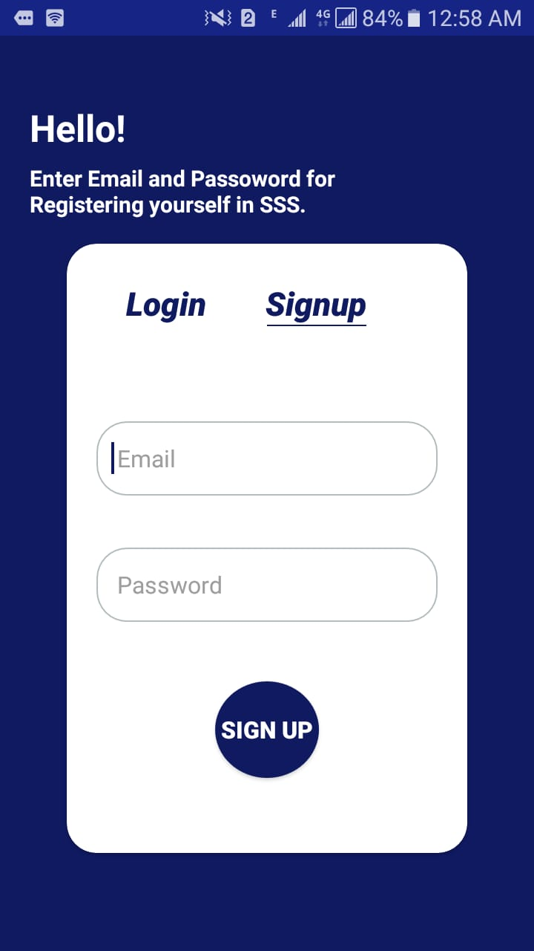
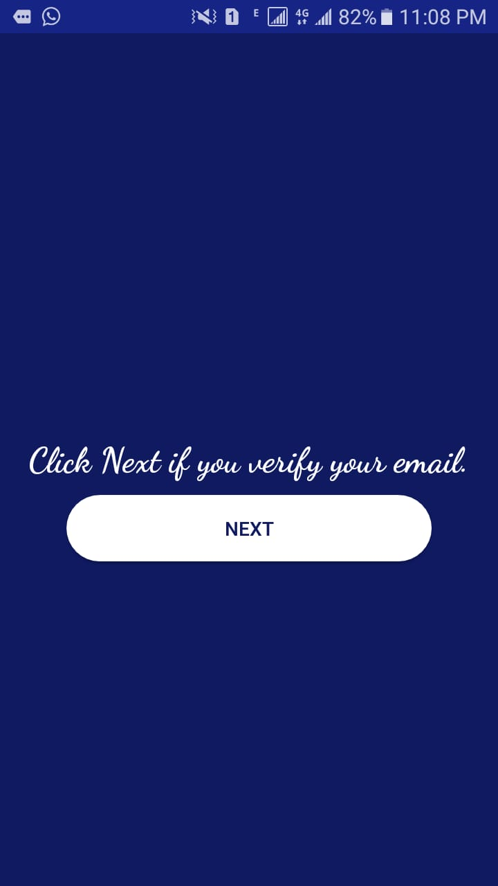
Student’s Signup Activity

Slide 25
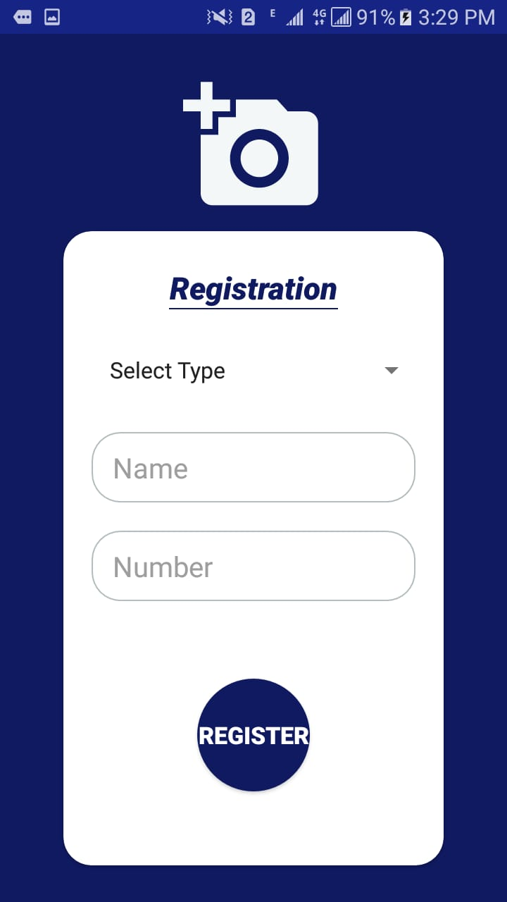
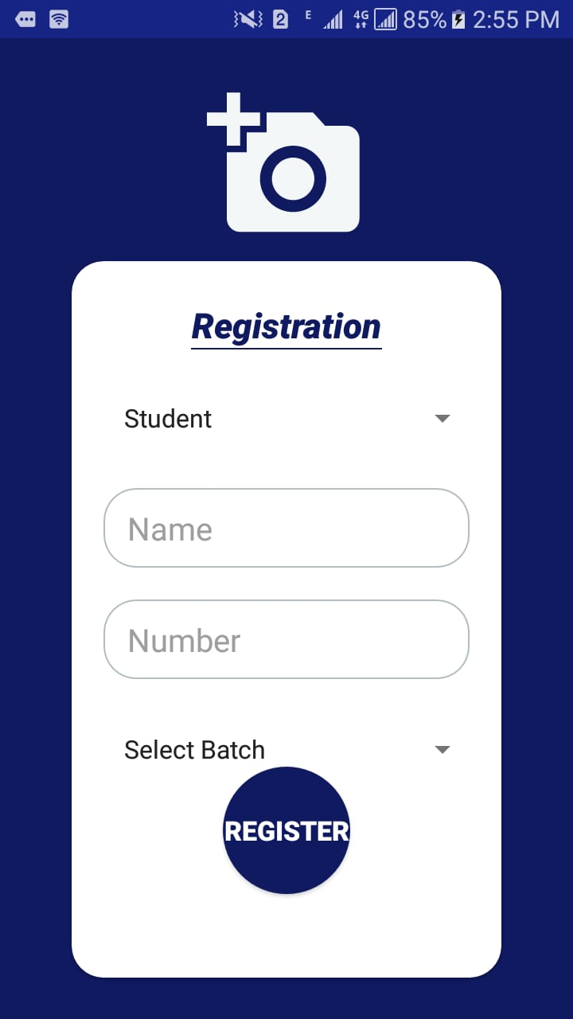
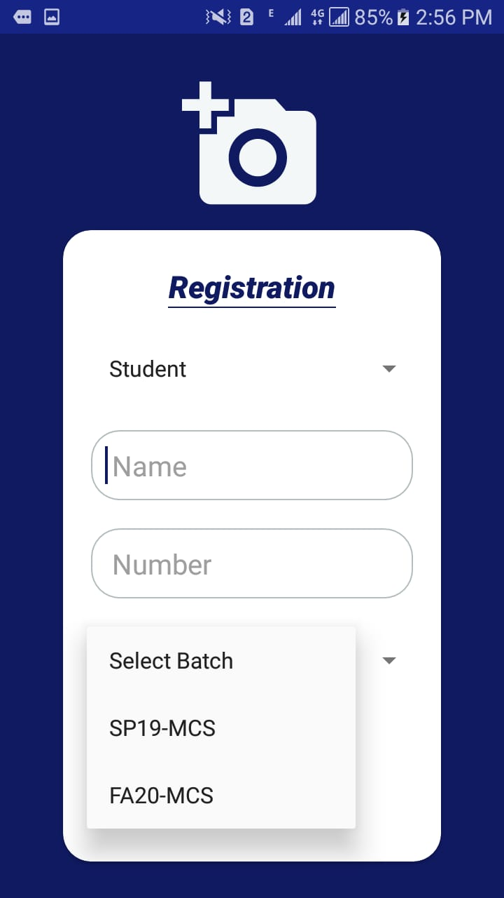
Student’s Registration Activity

Slide 26
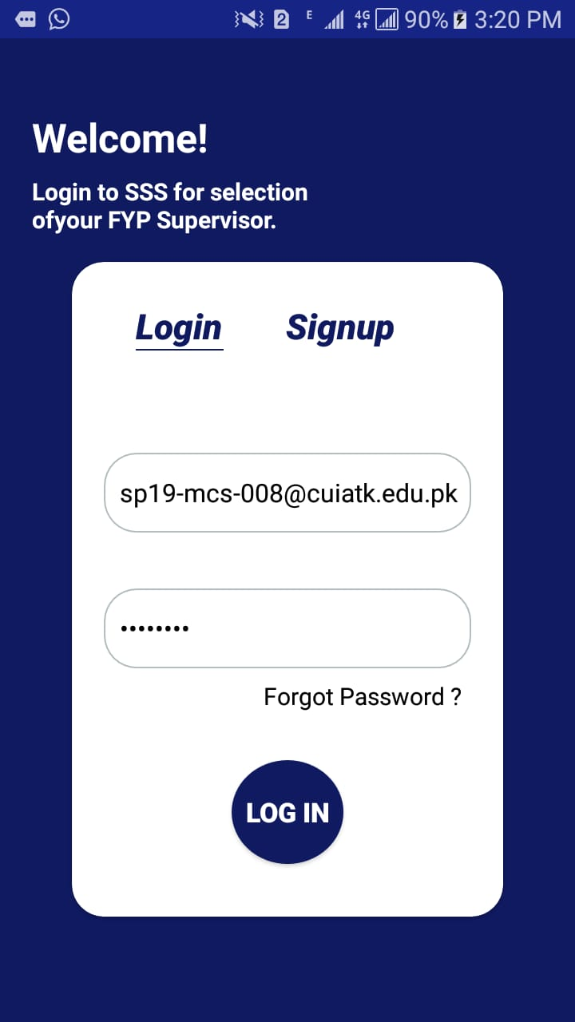
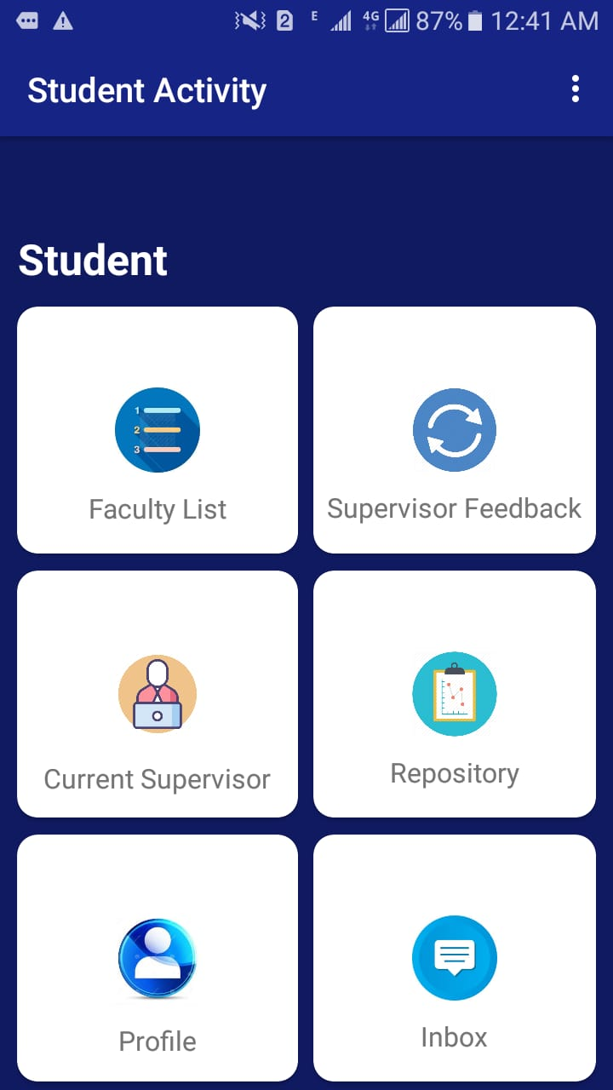
Student’s Login/Dashboard Activity

Slide 27
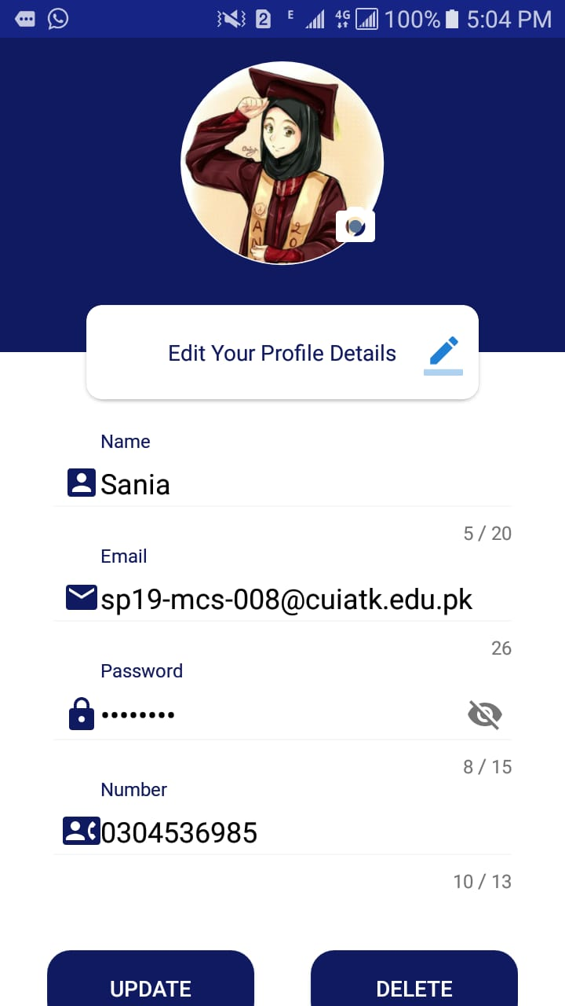
Student Profile Activity

Slide 28
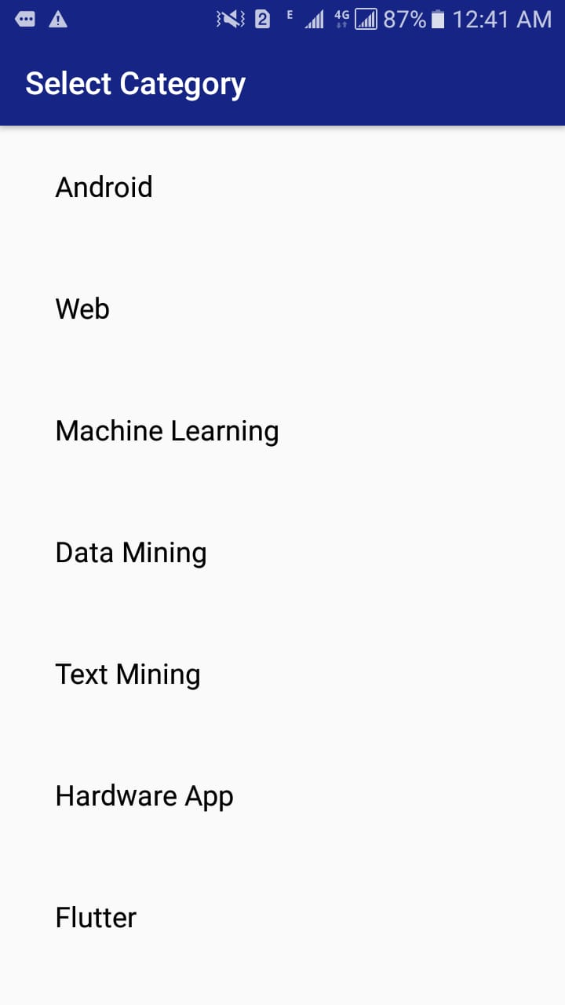
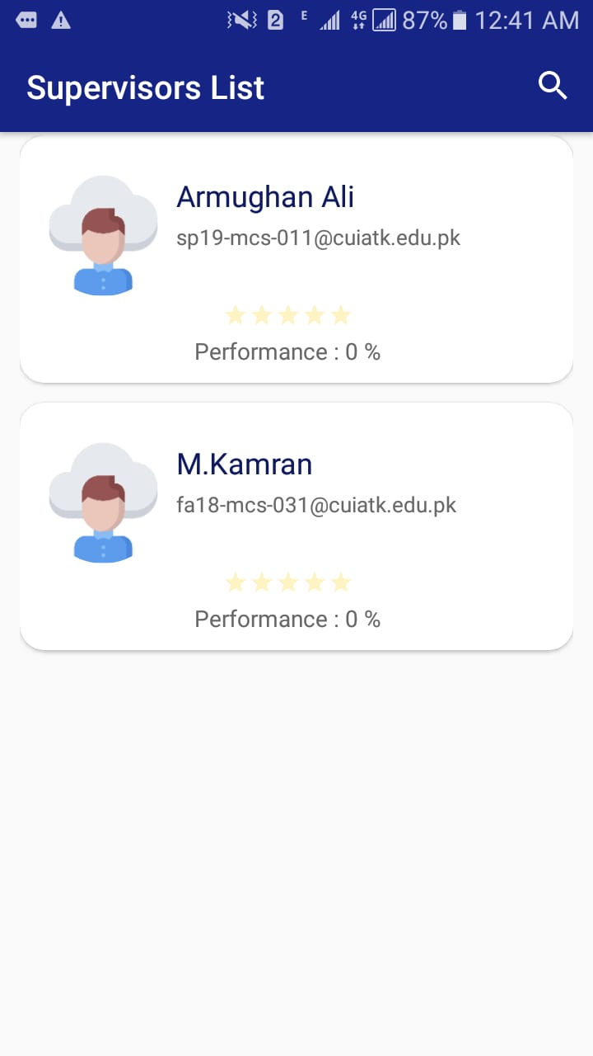
Faculty List Activity

Slide 29
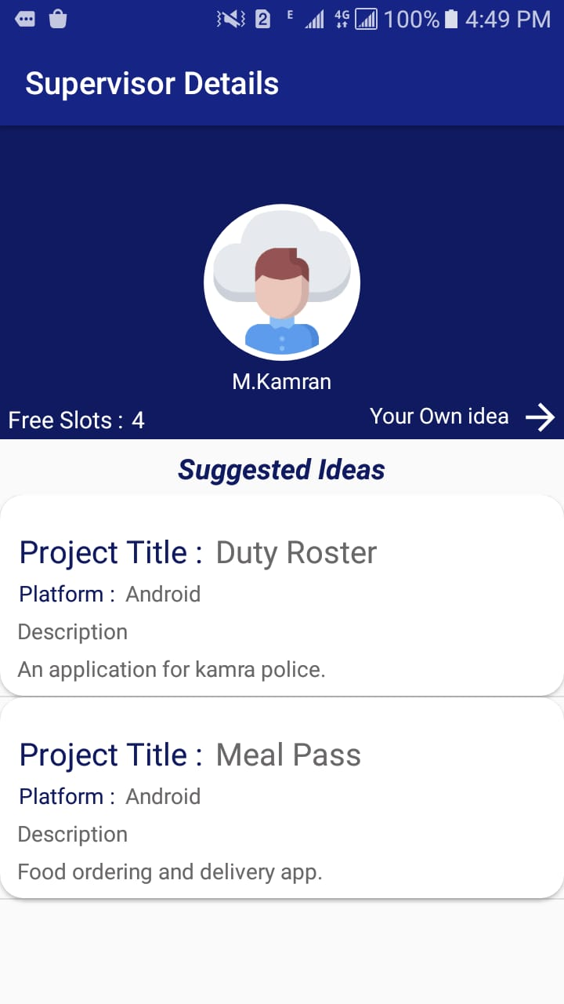
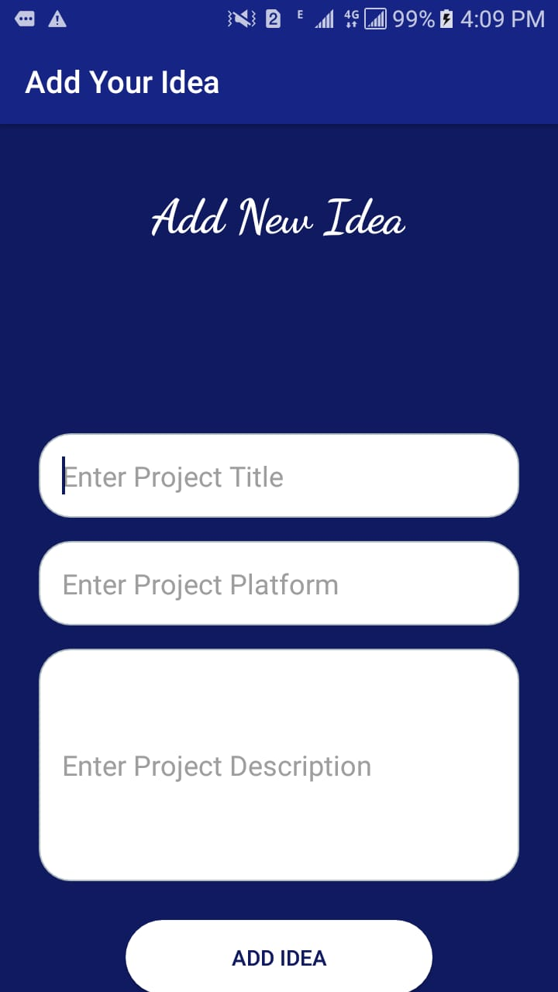
Continue….

Slide 30
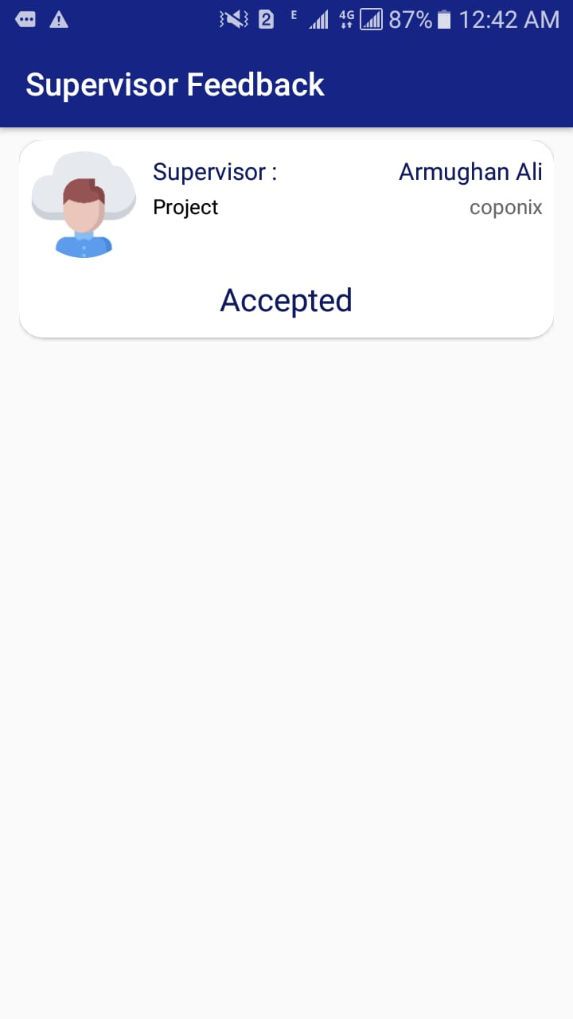
Supervisor Feedback Activity

Slide 31
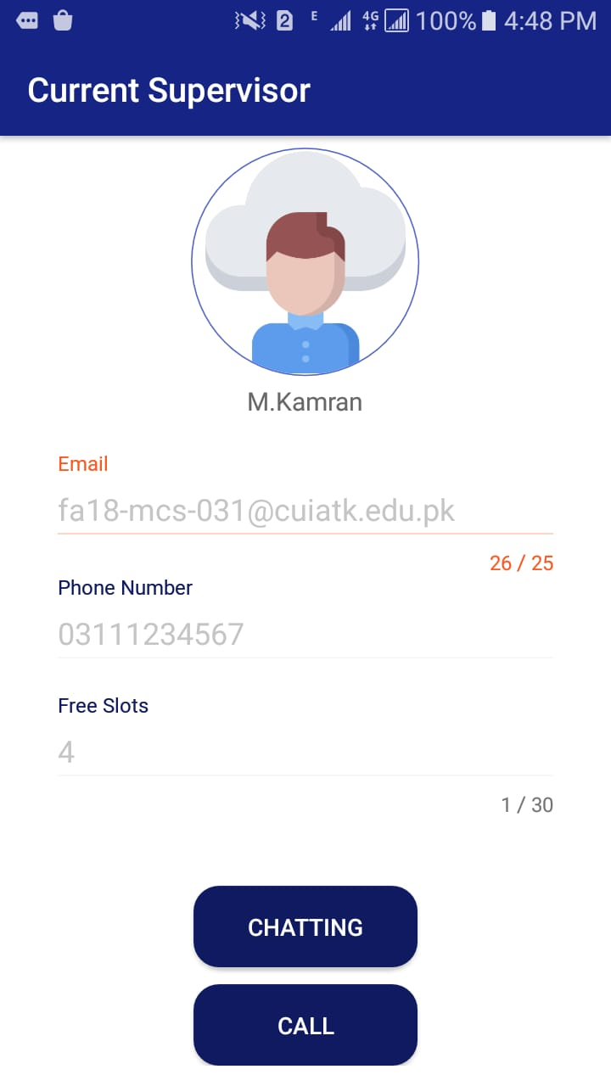
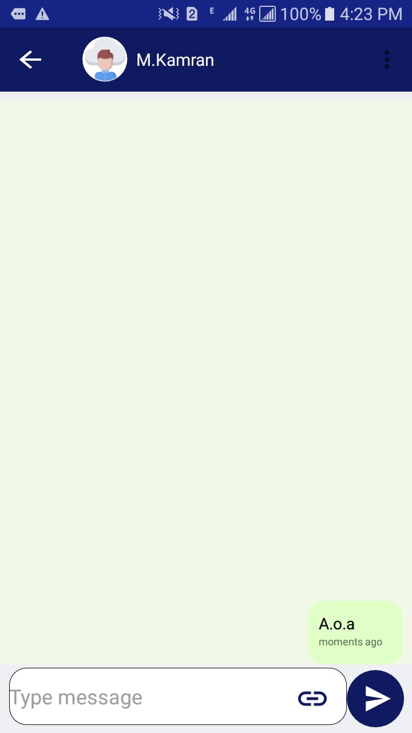
Student Current supervisor Activity

Slide 32
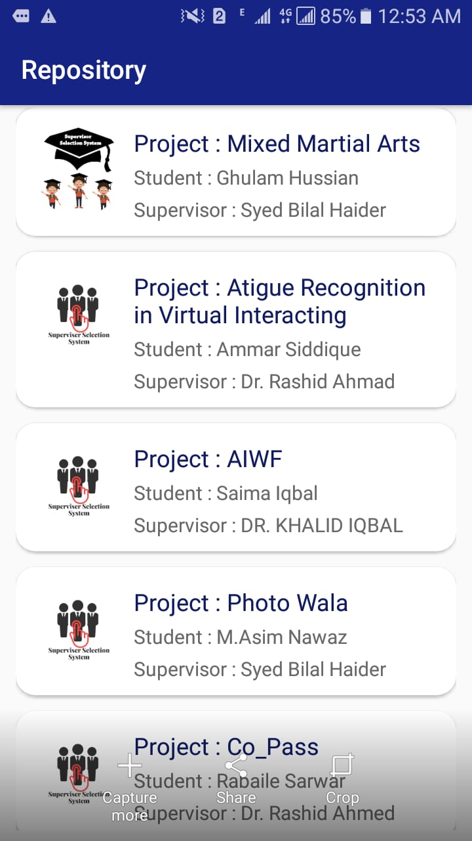
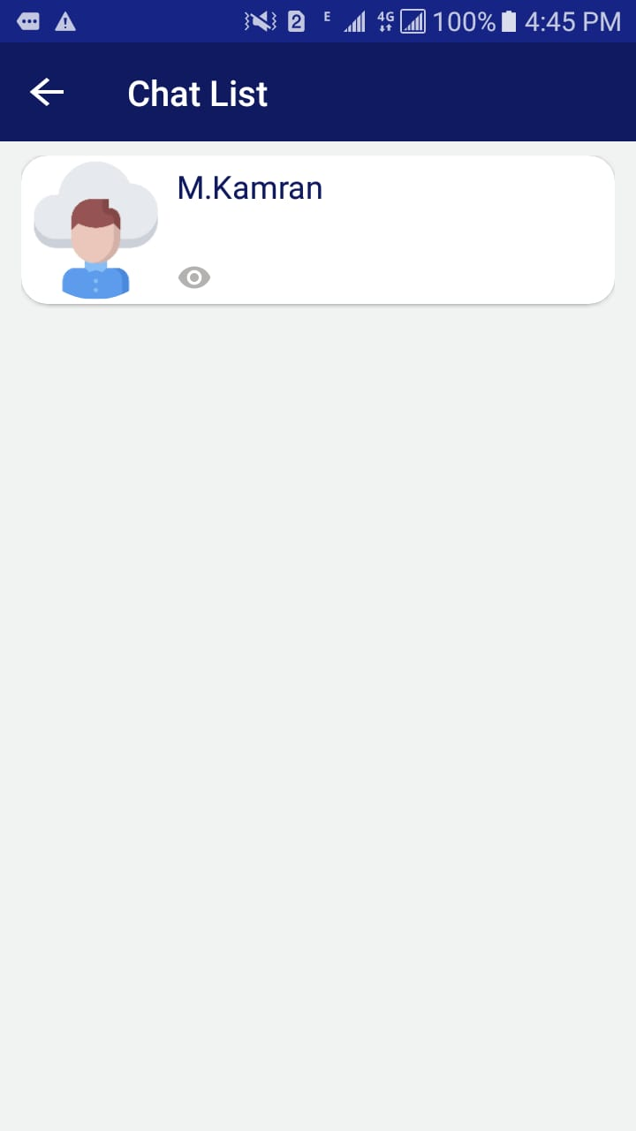
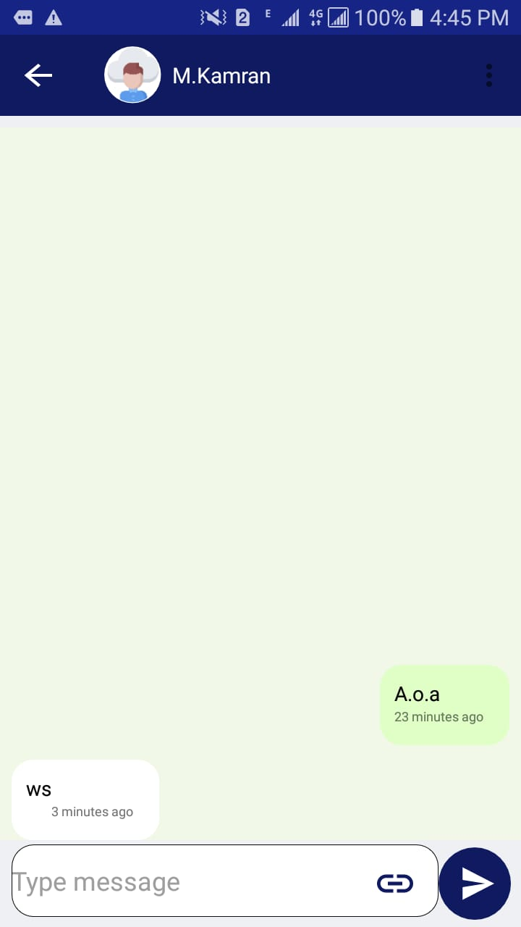
Repository /Inbox Activity

Slide 33
Supervisor’s Signup Activity

Slide 34
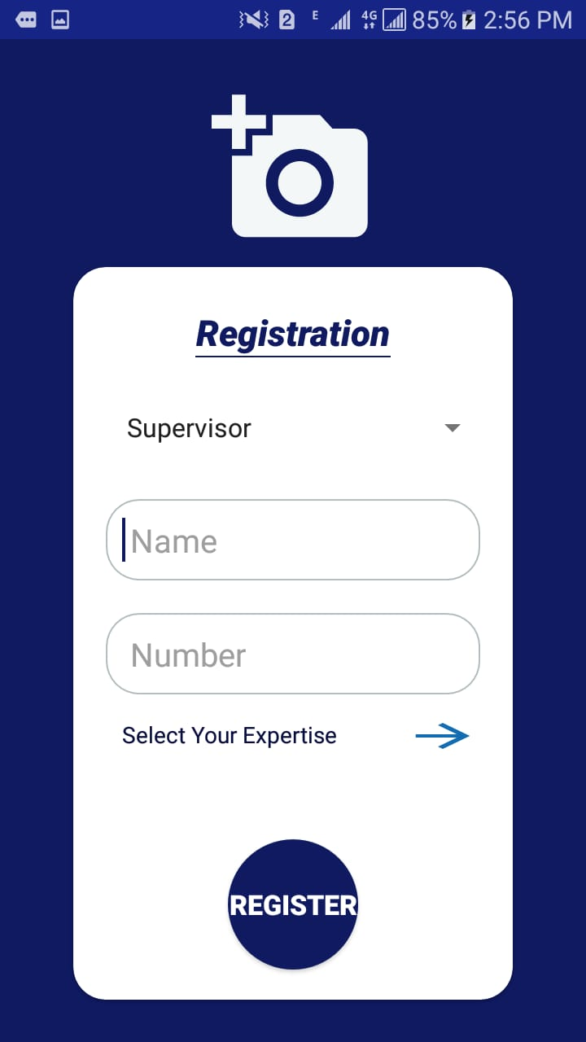
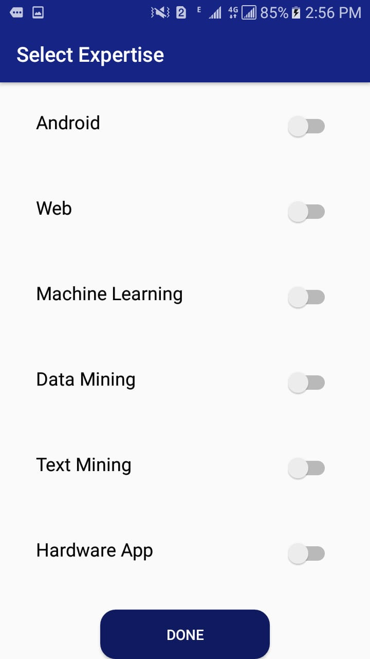
Supervisor’s Registration Activity

Slide 35
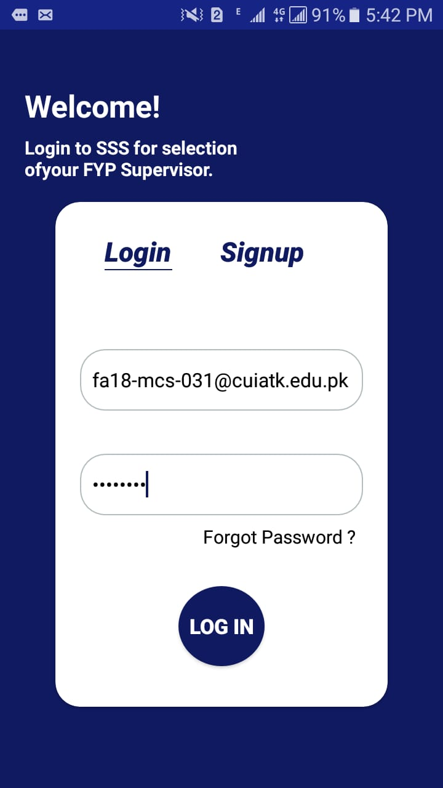
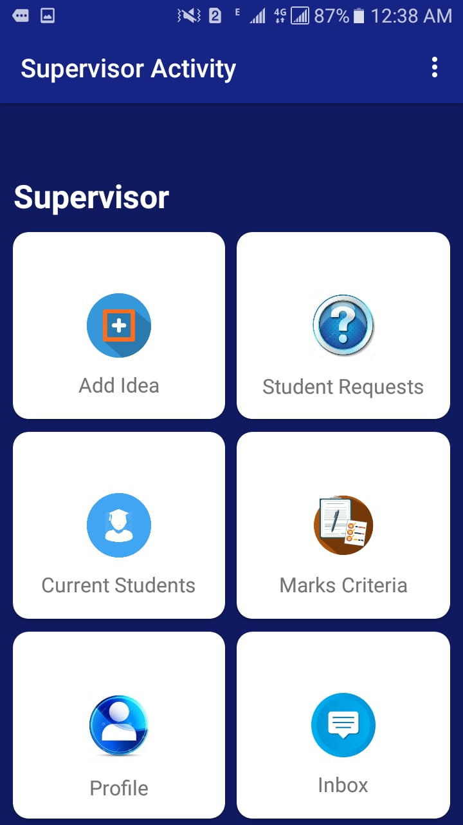
Supervisor’s Login/Dashboard Activity

Slide 36
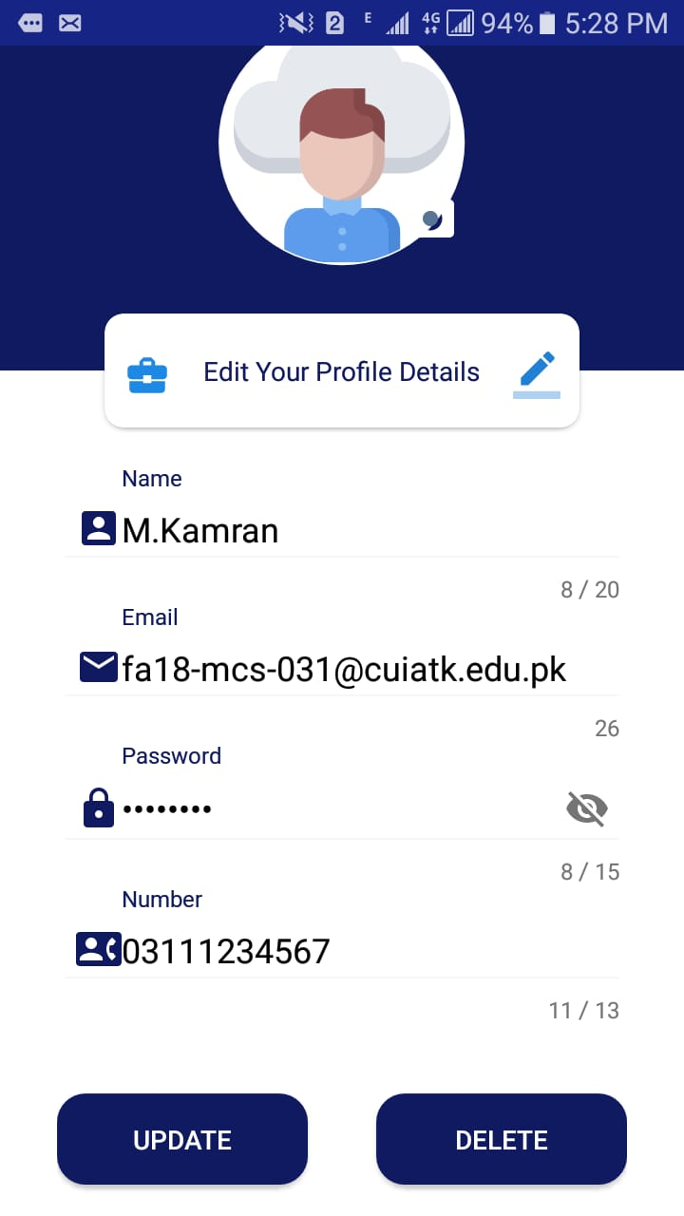
Supervisor Profile Activity

Slide 37

Add idea Activity

Slide 38
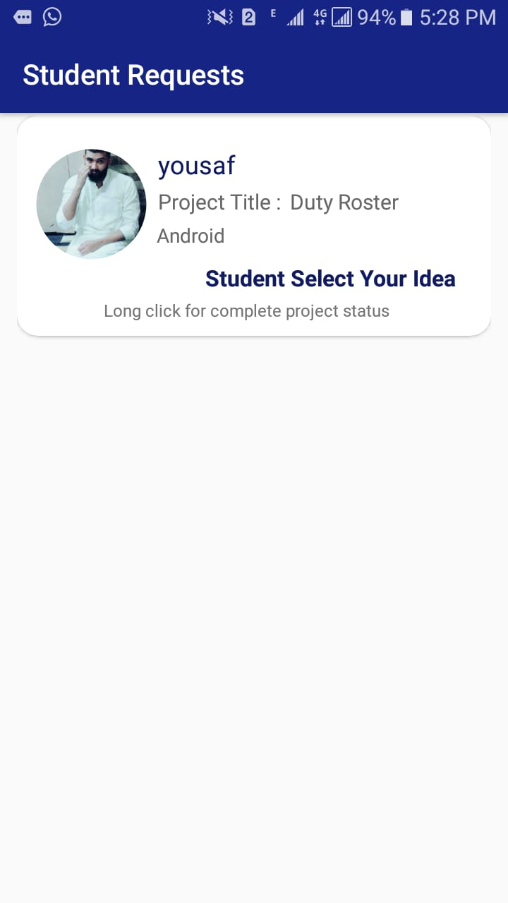
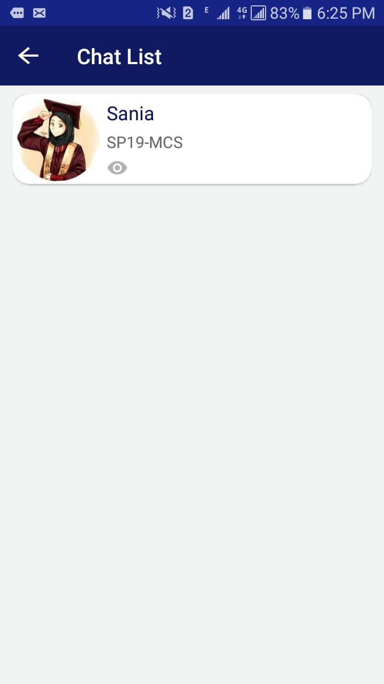
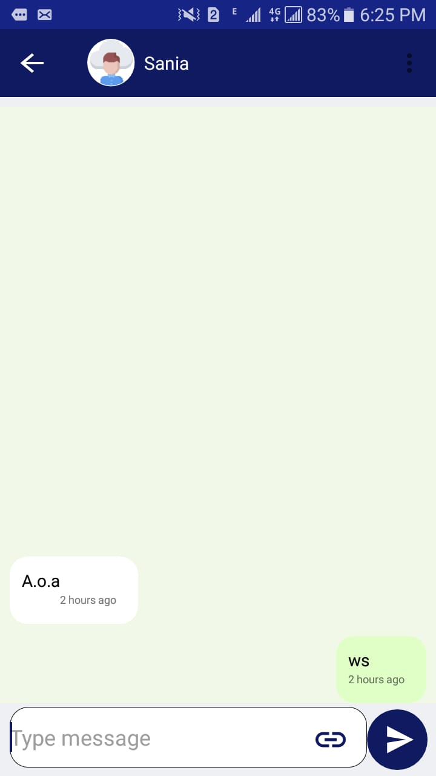
Student request/ inbox Activity

Slide 39
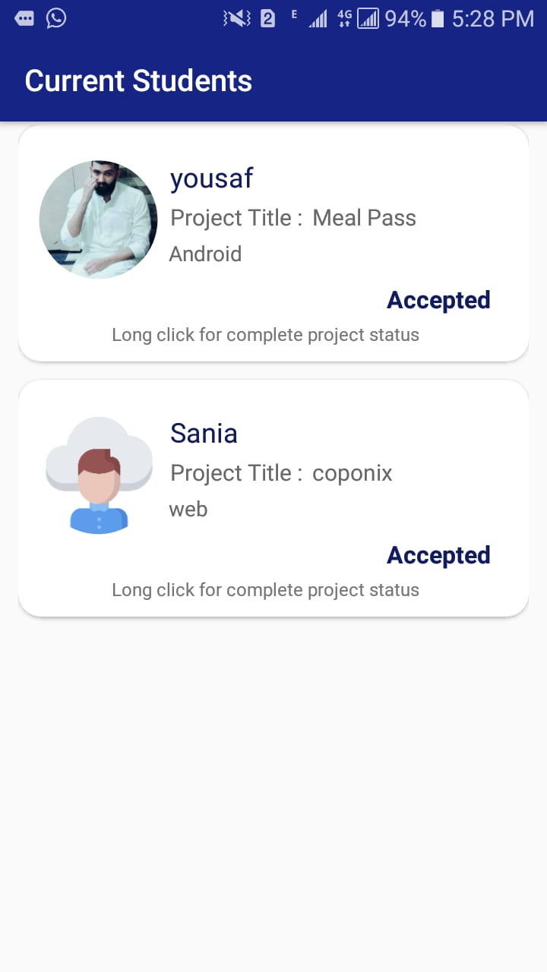
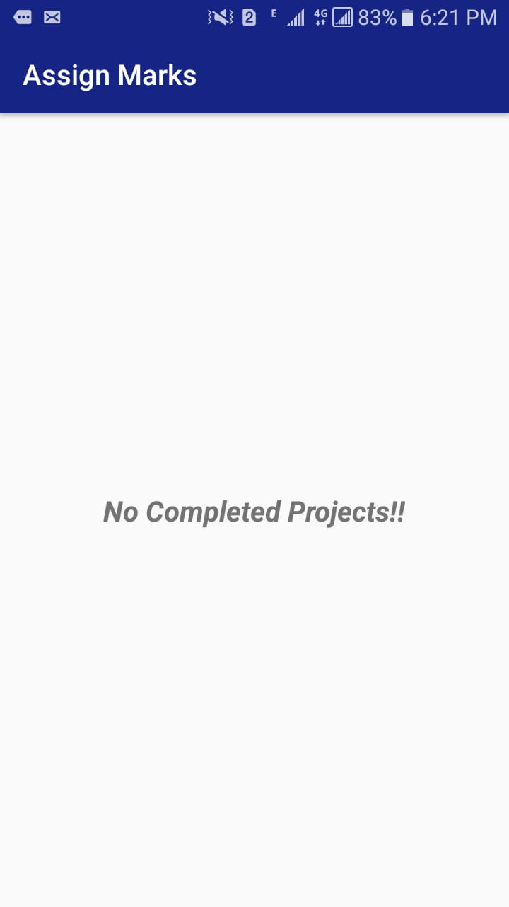
Supervisor current student/Marks Criteria Activity

Slide 40

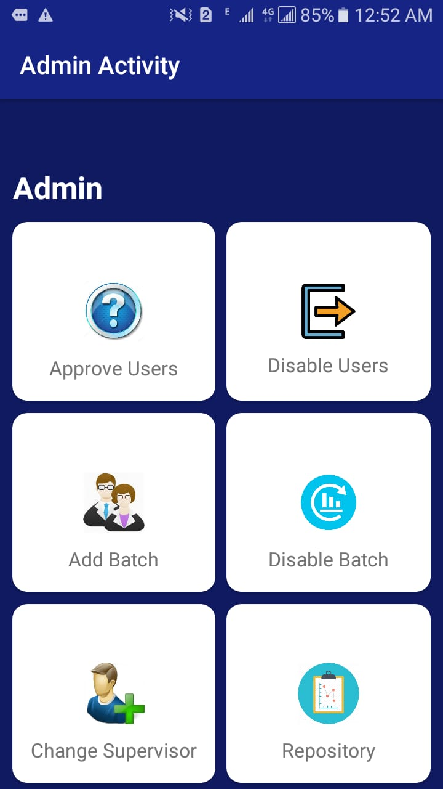
Admin’s Login/Dashboard Activity

Slide 41
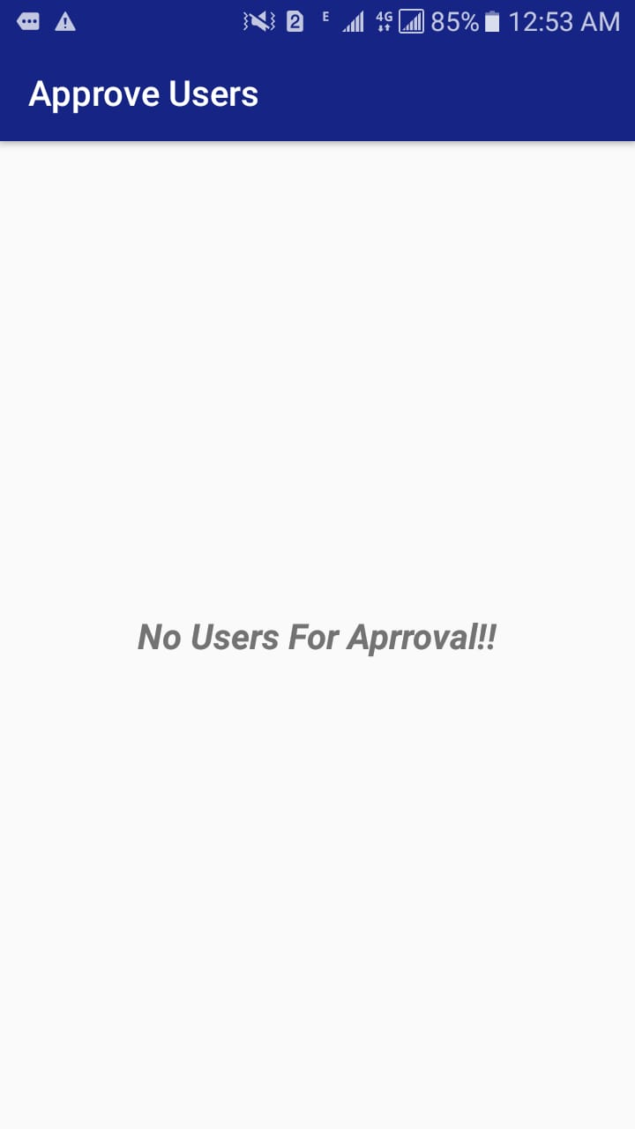
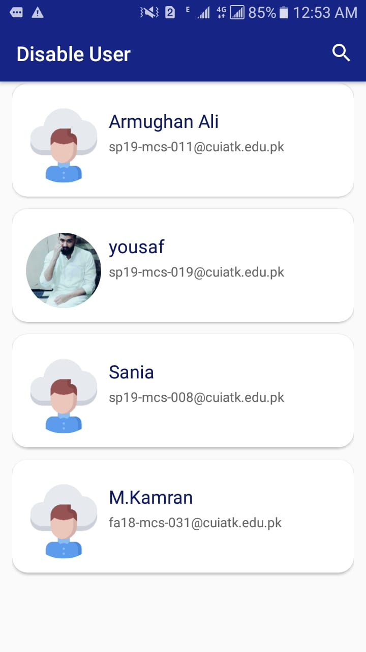
Approve User/Disable User Activity

Slide 42
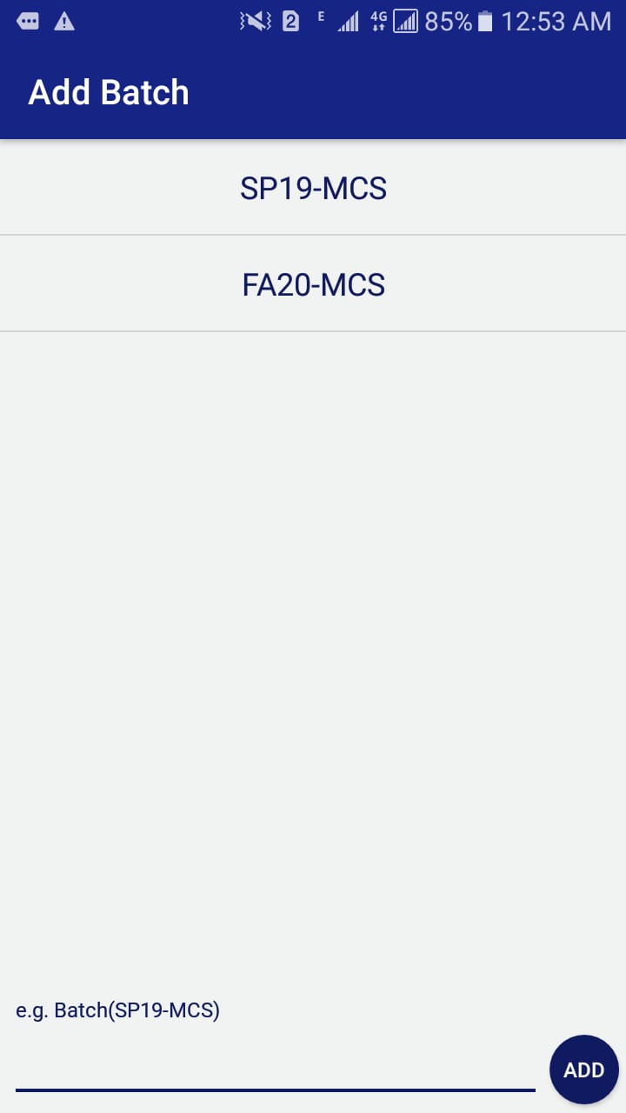
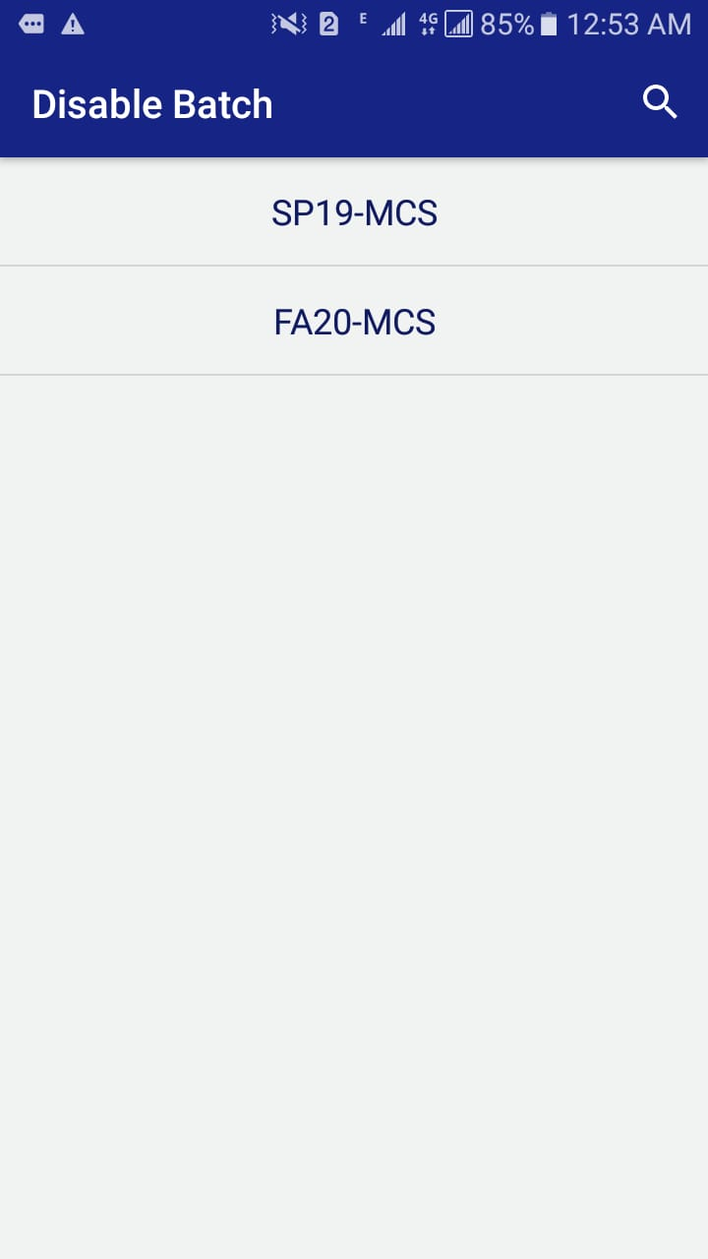
Add batch/Disable batch Activity

Slide 43
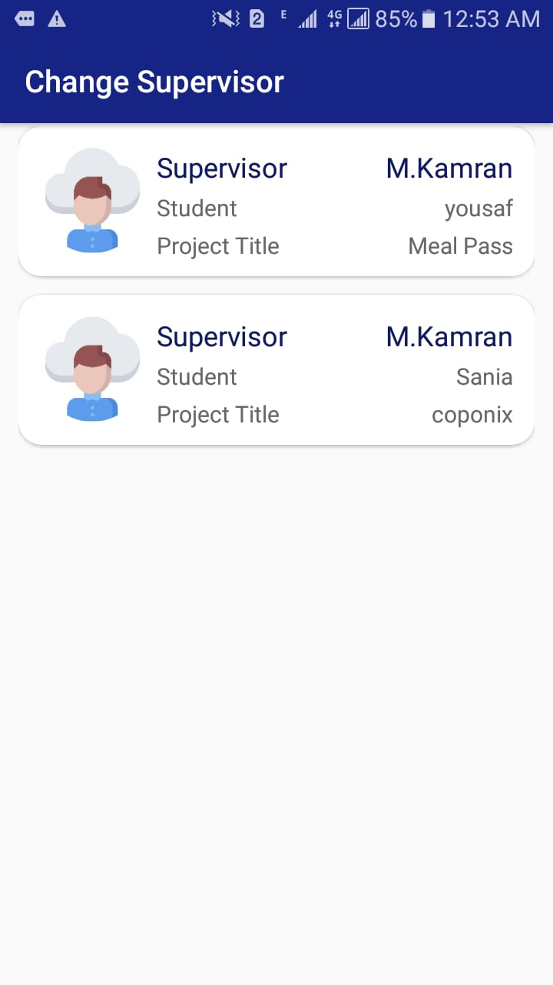
Change Supervisor/Repositry Activity

Slide 44
Conclusion
We learnt the usage of android studio & firebase or connection with different activities to each other.
This application is specially designed for those students who want to enroll in FYP and are searching for supervisor.
The main focus of the application was time saving and to simplify the activities of choosing supervisors for final year project.
This application have no bugs and also it is user friendly and working efficiently.

Slide 45
References
[1]"Firebase - Crunchbase". CrunchBase. Retrieved August 1, 2020.
[2] Grechanik, M. K. (2007). Recovering and using use-case-diagram-to-source-code traceability links . Proceedings of the the 6th joint meeting of the European software engineering conference and the ACM SIGSOFT symposium.
[3] "Firebase Auth". Firebase, Inc. Retrieved May 19, 2016.
[4] Methods. (n.d.). Retrieved from softwaretestingfundamentals: softwaretestingfundamentals.com
[5] Methods. (n.d.). Softwaretestingfundamentals.com.
[6] Methods (n.d). Firebase developer documentation: www.firebase.developer.com/docs.
[7] Methods (n.d). Google developer documentation: www.developers.google.com/docs.
[8] Schildt, H. (2010). Java: the complete reference. New York: McGraw-Hill Education.
[9] Pressman, R. S. (2005). Software engineering: a practitioner's approach. Palgrave macmillan.
[10] Google AdMob. (2006). Mobile Apps SDK(Android) :
www.developer.google.com/admob/android/quick-start

Slide 46


